Slide 1
AUTOMATIC ROOM LIGHTING SYSTEM
PRIYADARSHANI N. – 2020/E/120
PRIYATHARSINI S. – 2020/E/122
RAVINDYA L.B.T. -2020/E/132

Slide 2
TABLE OF CONTENTS
01
02
03
04
05
06
Introduction
Problems and Solutions
Component
Specification
Problems Faced
Timeline
Design

Slide 3
INTRODUCTION
The Automatic Room Lighting System using Arduino is an innovative project designed to enhance energy efficiency and convenience in homes, offices, and other spaces.
This system utilizes an Arduino Uno board to automatically control the lighting in a room based on human presence.
By detecting the entry and exit of people, the system turns the lights on when someone enters the room and off when the last person leaves.
This not only conserves energy but also adds a level of automation that simplifies daily life.

Slide 4
PROBLEM
SOLUTION
The inefficient use of lighting in homes and workplaces due to lights being left on when no one is present, resulting in unnecessary energy consumption and increased electricity bills.
An Automatic Room Lighting System using an Arduino Uno and IR sensors turns lights on and off based on room occupancy to save energy and enhance convenience.

Slide 5
WHAT IS THE problem and it’s solution?
Lights are often left on in homes and workplaces when no one is present, leading to unnecessary energy consumption and increased electricity bills. Manual operation is inconvenient and prone to human error, such as forgetting to turn off lights.
The proposed solution is an Automatic Room Lighting System using an Arduino Uno microcontroller, which uses IR sensors to detect movement and a bidirectional visitor counter to track occupancy. This system turns lights on when the first person enters and off when the last person leaves, saving energy and providing convenience.

Slide 6
SCOPE
?
?
The scope of this project includes developing an automatic lighting control system using an Arduino Uno, incorporating IR sensors to detect human movement, and creating a bidirectional visitor counter to track room occupancy.
The system will be integrated to control lighting based on the number of people in the room, followed by testing and validation to ensure its reliability and efficiency.

Slide 7
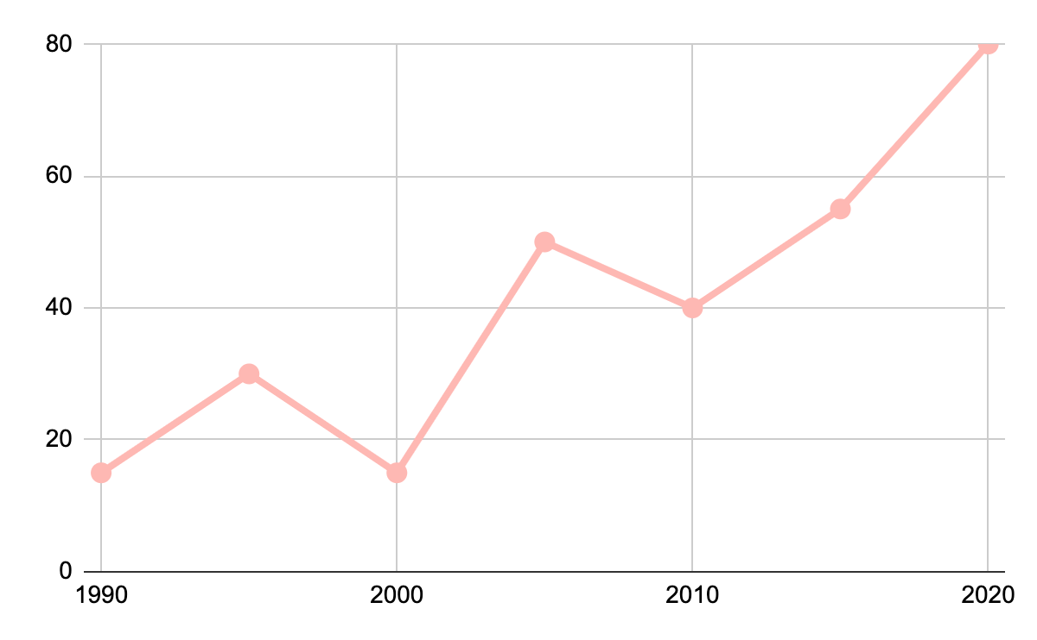
…OBJECTIVES…
The primary objective of the Automatic Room Lighting System is to reduce unnecessary energy consumption by ensuring lights are only on when a room is occupied.
The system aims to provide a convenient, hands-free solution to lighting control, eliminating the need for manual operation and minimizing human error. This enhances energy efficiency and lowers electricity bills while maintaining optimal lighting conditions

Slide 8
FUNCTIONALITIES
01
02
03
04
The Automatic Room Lighting System automates the control of lights based on room occupancy.
It uses infrared (IR) sensors to detect human movement at entry and exit points.
A bidirectional visitor counter tracks the number of people in the room.
When the first person enters, the system activates the lights, and when the last person exits, the lights turn off.

Slide 9
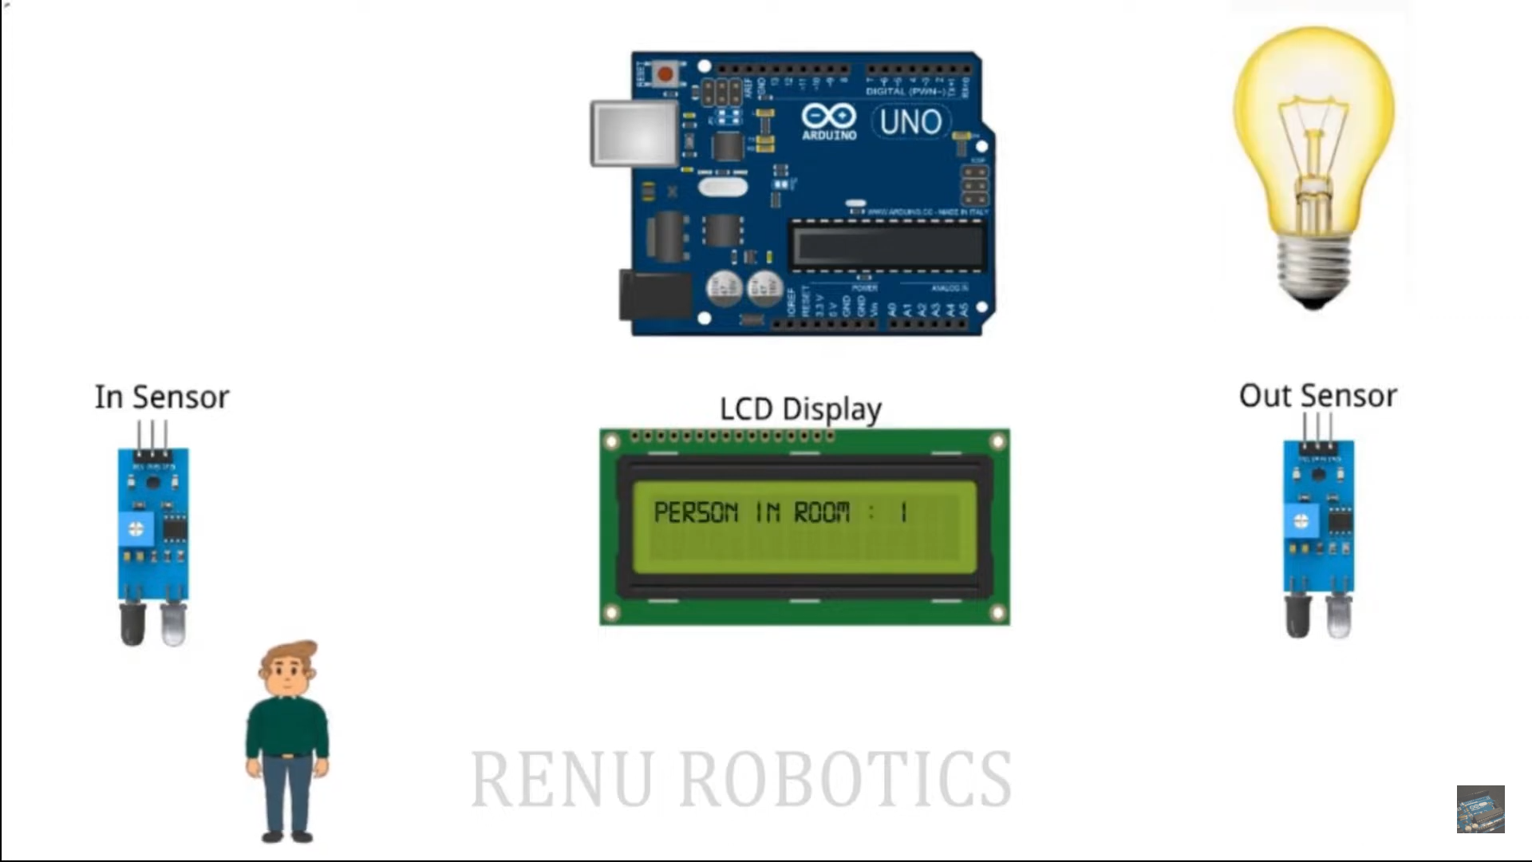

Slide 10
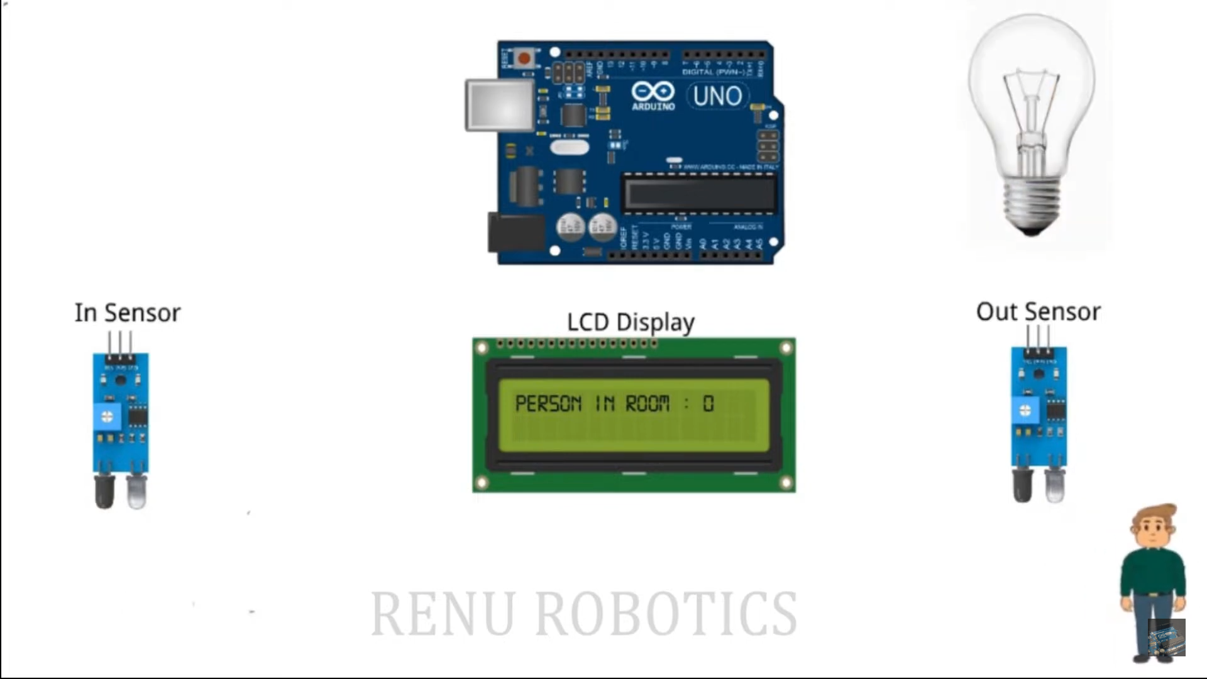

Slide 11
COMPONENT SEPECIFICATION
ARDUINO UNO
LCD DISPLAY
IR SENSORS
RELAY MODULE
Microcontroller: ATmega328P
Operating Voltage: 5V
Input Voltage: 7-12V
Digital I/O Pins: 14 (of which 6 provide PWM output)
Analog Input Pins: 6
Clock Speed: 16 MHz
Display Size: 16 characters x 2 lines
Operating Voltage: 5V
Character Resolution: 5x8 dots
Controller: HD44780 or equivalent
Operating Voltage: 3.3V-5V
Detection Range: Typically 2-30 cm
Output Type: Digital signal
Operating Voltage: 5V
Channel: Single channel
Control Signal: 5V TTL
Switching Capacity: 10A 250VAC / 10A 30VDC

Slide 12
COST
Component | Cost(LKR)
Arduino Uno | 2490.00
16/2 LCD Display | 340.00
IR Sensors(2) | 190.00
Relay module | 480.00
Breadboard | 125.00
Arduino Uno Data Cable | 90.00
9V Battery | 150.00
9V Battery Connector | 50.00
Male to Male Jumper Wires | 150.00
Female to Male Jumper Wires | 150.00
Light Bulb | 800.00
Light Bulb Socket | 150.00
Total Cost : RS. 5165.00

Slide 13
DESIGN
?
The circuit design for the Automatic Room Lighting System involves using an Arduino Uno, two IR sensors, and a relay module. The IR sensors are placed at the entry and exit points to detect movement, while the Arduino processes these signals to control the relay, which turns the lights on or off based on room occupancy.

Slide 14
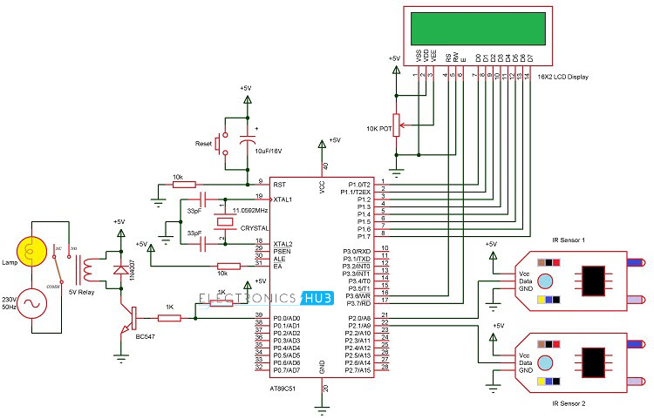

Slide 15
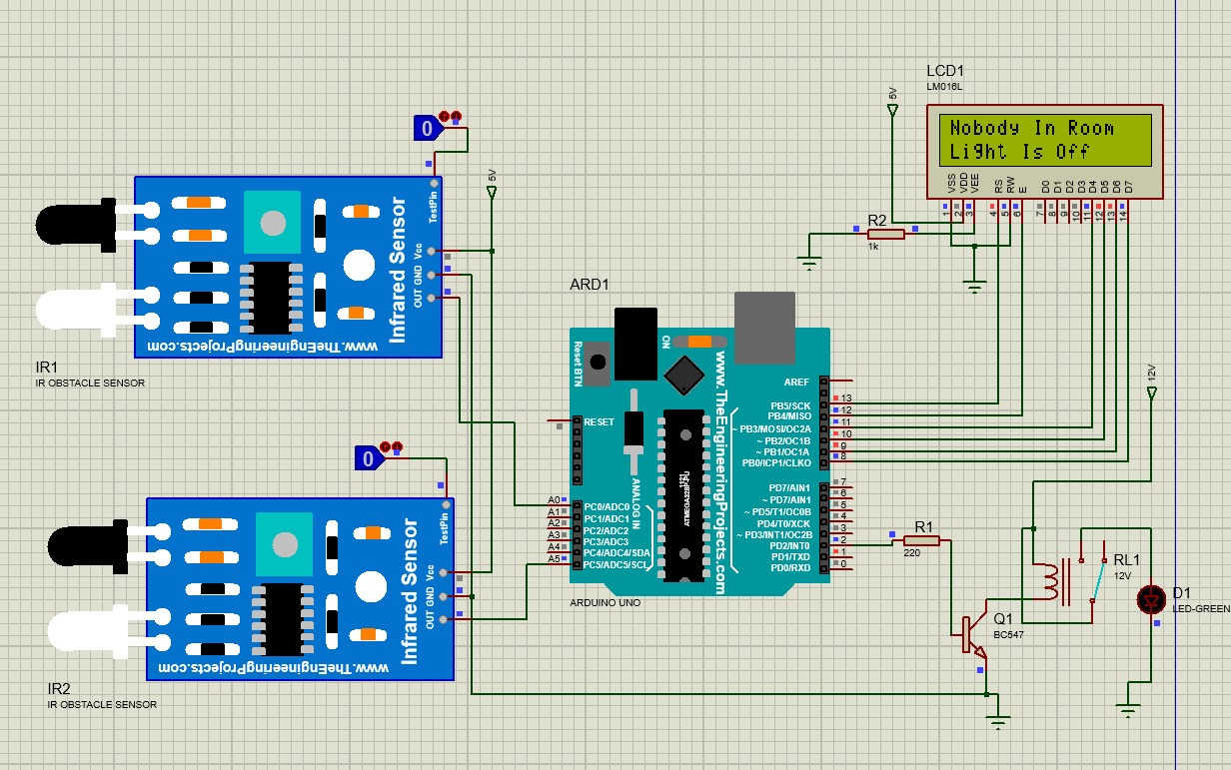
PROTEUS DESIGN

Slide 16


Slide 17
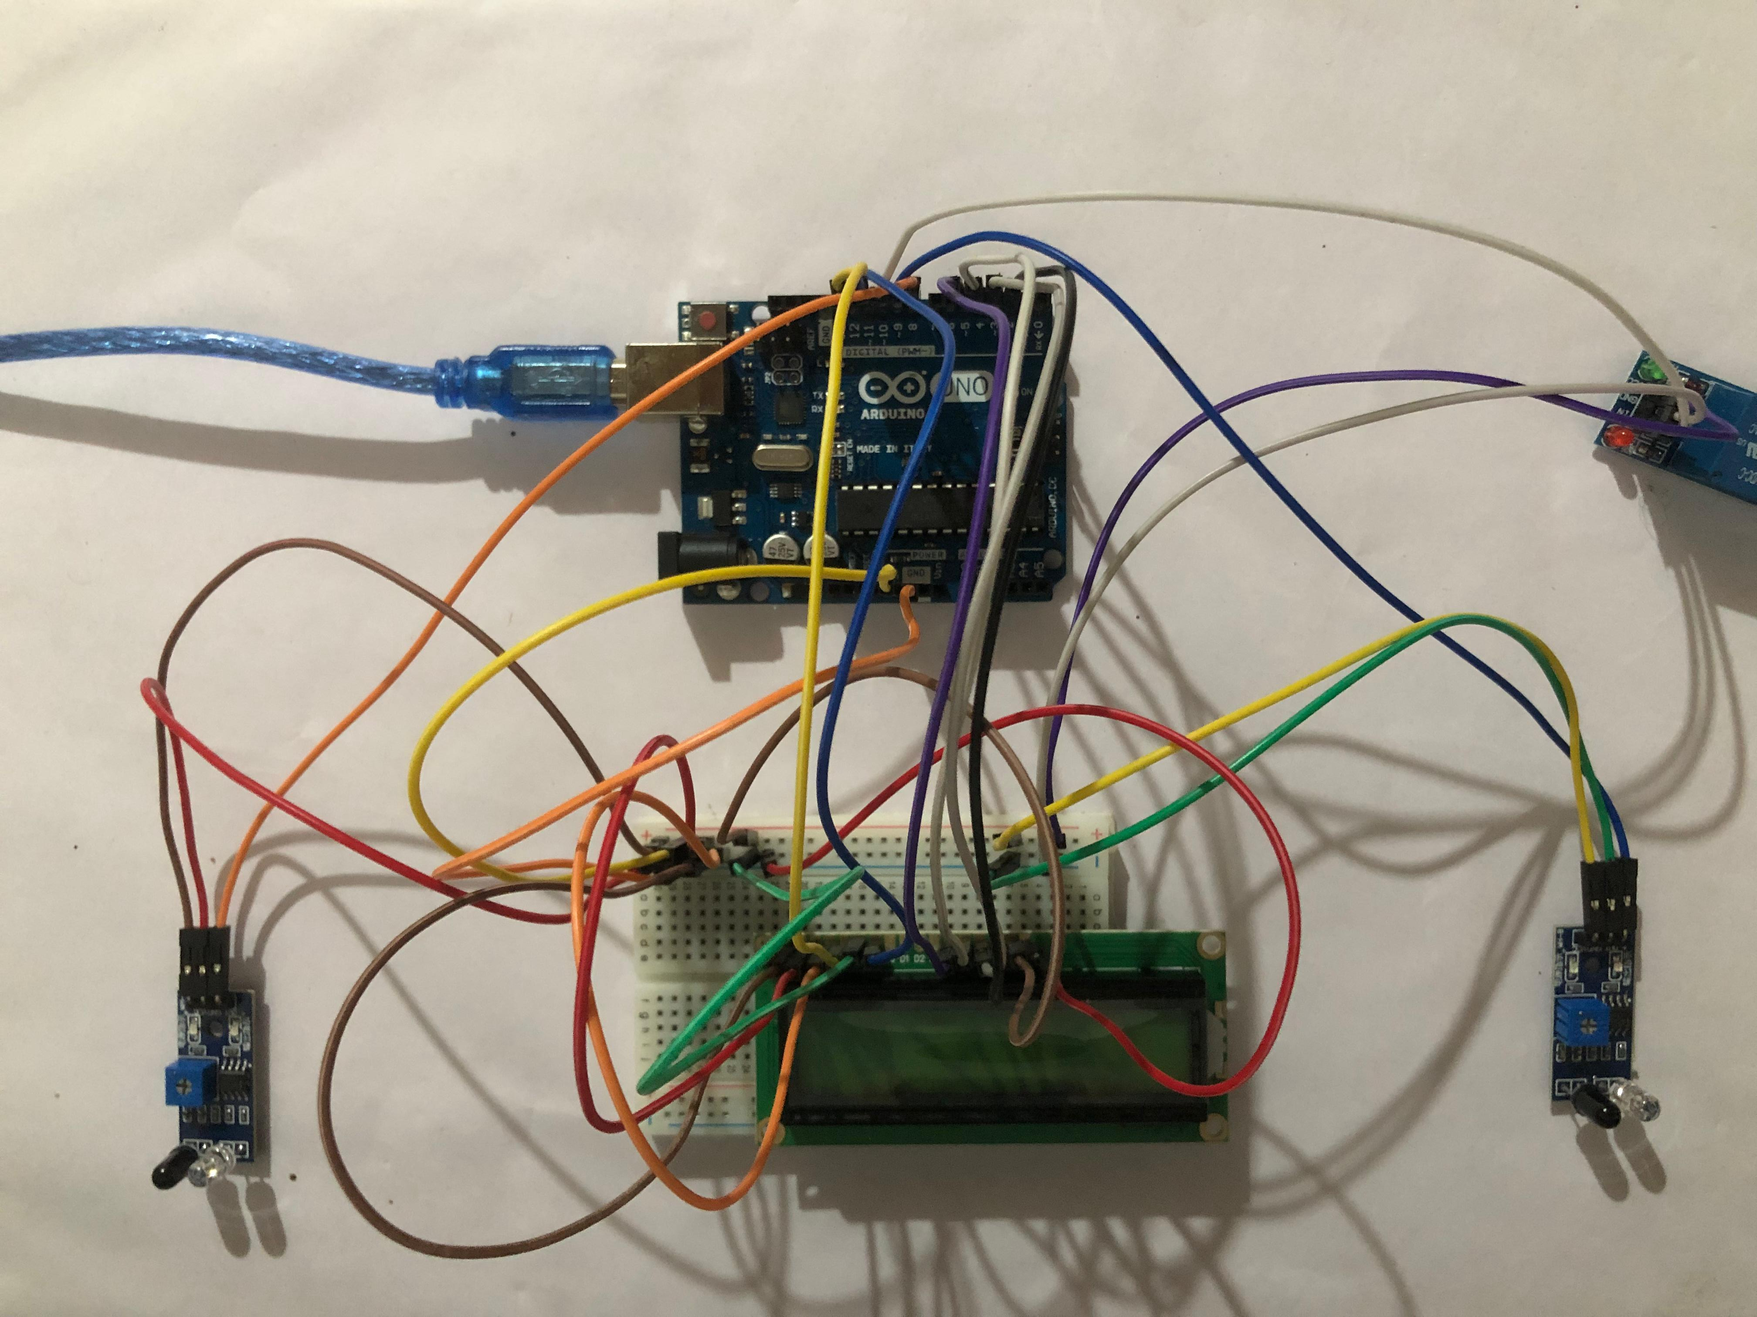
HARDWARE DESIGN
(The power supply was not given to the circuit here. This is the main circuit in progress)

Slide 18
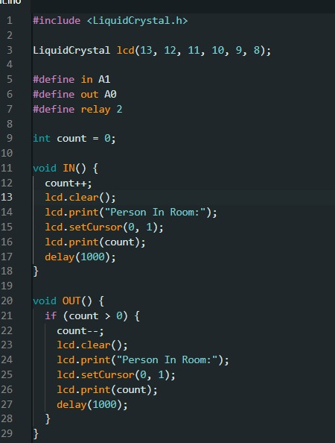
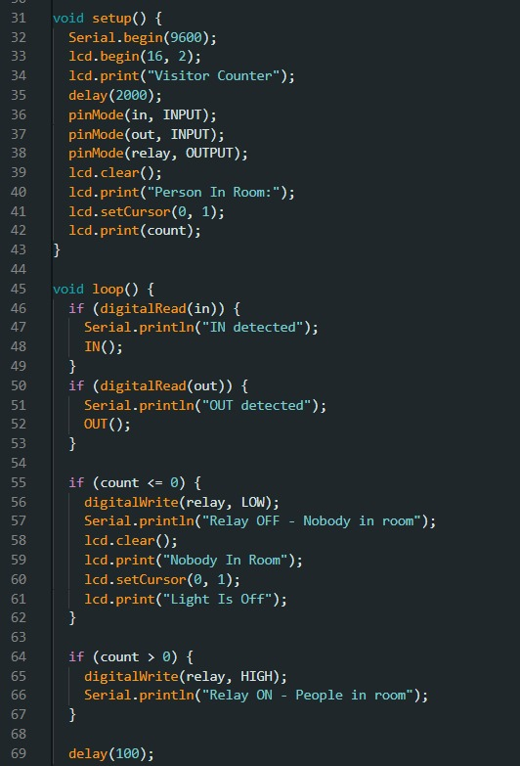
CODE

Slide 19

NEXT STEP…
Complete the final testing and validation of the system.
Document the entire process and results for the final report and presentation.
Prepare for the demonstration and evaluation of the final prototype.

Slide 20
PROBLEM FACED
SENSOR ACCURACY
CALIBRATION
POWER SUPPLY ISSUES
INTERFERENCE
IMPLEMENTATION IN LARGE SPACES
SYSTEM RELIABILITY
Ensuring that IR sensors accurately detect movement and differentiate between entry and exit movements.
Properly calibrating the sensors and visitor counter to ensure accurate counting of occupants.
Managing power requirements and ensuring a stable power supply for the Arduino and connected components.
Addressing any interference from other electronic devices that might affect sensor performance.
Adapting the system for larger rooms or multiple entry/exit points, which might require additional sensors and complex programming.
Ensuring the system operates reliably over time without false triggers or failures.

Slide 21
DEVIATION
FROM
PROPOSAL
The original project proposal planned to use an 8051 microcontroller, but due to unavailability in local stores, the development board was changed to an Arduino Uno.
The core functionalities, including the automatic lighting control and bidirectional visitor counter using IR sensors, remained consistent with the initial objectives.
This adjustment required modifications to the programming and circuit design to be compatible with the Arduino platform.

Slide 22
PROGRESS
Since the project began, the team successfully adapted the design to the Arduino Uno, assembled the necessary components, and developed the control algorithms for the automatic lighting system.
The IR sensors and bidirectional visitor counter were implemented and tested for accuracy, ensuring the system's functionality and reliability in detecting room occupancy.

Slide 23
timeline
Activity Week | 07 | 08 & 09 | 10 | 11 | 12 | 13 | 14
Title Selection and Project Proposal
Understanding The Project Deeply
Working On the Programming Part of The Project
Collecting And Assembling the Hardware Components
Software Implementation to The Microcontroller and Testing the Final Prototype
Demonstration And Evaluation of The Prototype

Slide 24
—Team CG11
THANK you

